Slide 1

Welcome Everyone!
Sujit Molleti

Slide 2
Start Recording

Slide 3
Object Oriented Programming
Week 12

Slide 4
THIS IS THE MOST IMPORTANT CONCEPT IN ALL OF PROGRAMMING!!!

Slide 5
Object-Oriented Programming
- Objects
Types that you create yourself
Right now we have String, Array…we can make our own now!!!
An object class is like a blueprint
We want to establish common traits (fields) and common behavior (methods)

Slide 6
What makes up an Object
Object classes have 3 important parts
Constructor(s)
Fields
Instance Methods
Baby john = new Baby(“blue”, “john”, 1);
Similar to how you declare an Array
Order of parameters matters!
Left side is declaring type and variable name
Right side is allocating memory and creating an instance

Slide 7
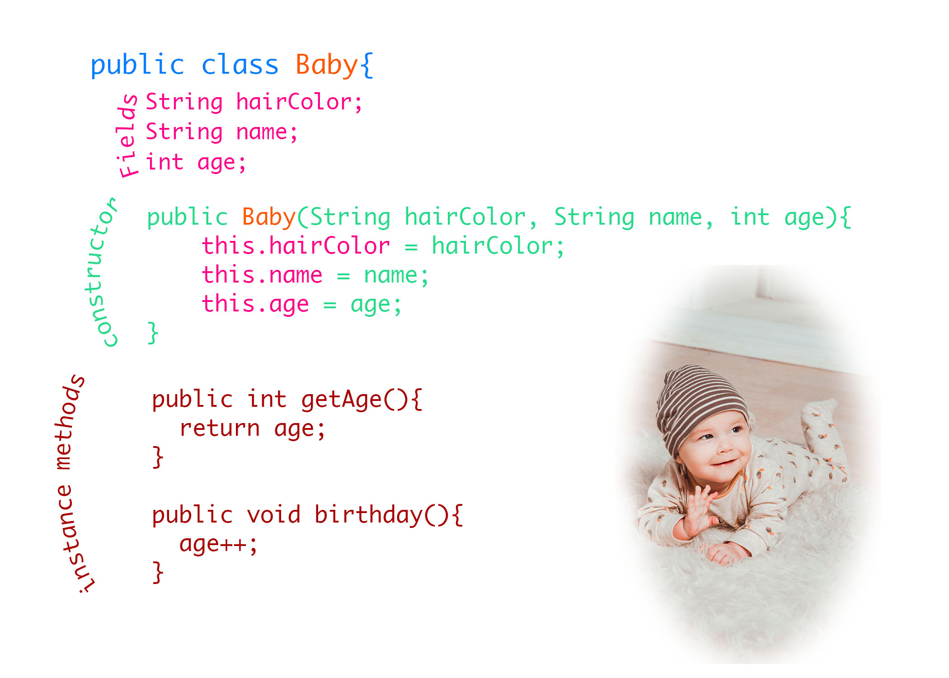

Slide 8
Questions
What is the difference between the classes I have now and Object classes?
What is the difference between the difference between and instance method and a normal method?
This seems different from what we’ve been doing how can I get comfortable?

Slide 9
Problems

Slide 10
Quiz Code: H1SW
Section 53

Slide 11
Quiz Code: ZMM9
Section 19

